Slide 1
5 techniques of public speaking lessons

Slide 2
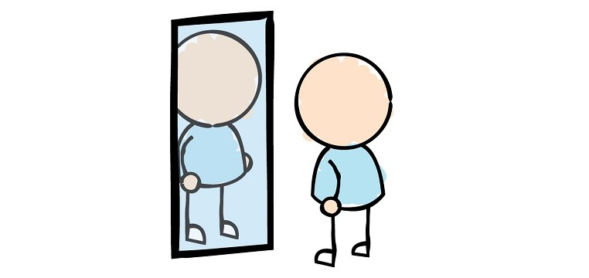
posture
Posture is how you physically present yourself while speaking.

Slide 3
Posture
Good Posture
Poor Posture
Feet shoulder width apart
Plant feet firmly
Relaxed, natural pose
Face audience
Use hand gestures
Stiff pose
Leaning, slouching, fidgeting
Head down, don’t face audience
Arms crossed, in pockets, not making hand gestures

Slide 4
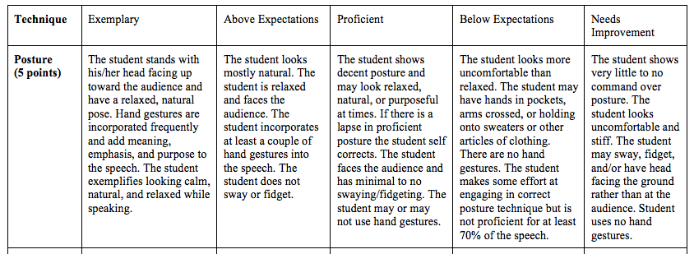

Slide 5
Projection
Projection is how well you can be heard while speaking

Slide 6
Projection
Good Projection
Poor Projection
Speaking from your core
Aim voice at the audience
Volume is appropriate for the circumstances
Volume may change depending on speech topic
Breathing appropriately
Whispering, speaking too low
Yelling or speaking in a volume inappropriate to the topic
Items in front of face
Projecting voice at the back of the room or floor

Slide 8
enunciation
Enunciation is how well you can be understood while speaking

Slide 9
enunciation
Good Enunciation
Poor Enunciation
Speaking clearly
Every syllable understood
Words are pronounced properly
Mouth is moving
Speech is paced appropriate to subject
Uses correct emphasis, inflection
Mumbles
Mispronounced words
Words slurred together
Pace either too fast or too slow
Speaking while chewing

Slide 10
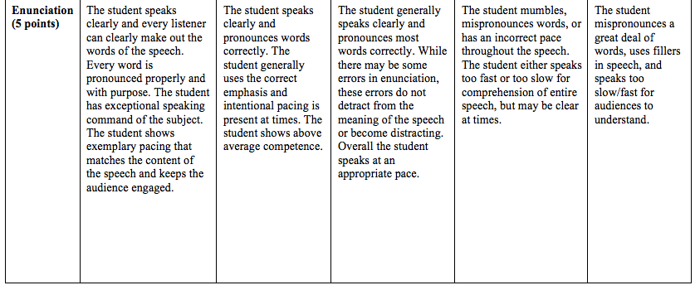

Slide 11
confidence
Confidence is how you present yourself emotionally

Slide 12
Confidence
Good Confidence
Poor Confidence
Eye contact with entire audience
Pride and passion in topic
Speaker knows content and is familiar with speech
Shows practice and polish
Does not believe in what is being said
Apologizing, becoming confused
Appears nervous or rushed
No eye contact

Slide 13
Confidence (10 points) | The student shows fantastic confidence, pride, and belief in what he/she is saying. The speaker has purpose and is sure of the content of the speech. The student is polished and prepared from start to finish. The student knows every element of the speech. The student makes appropriate and consistent eye contact with the entire audience. | The student shows familiarity and pride in his/her speech. The student appears rehearsed and confident but may increase mastery through increased practice, passion, or knowledge of speech content. The student knows almost all the elements of the speech. The student makes regular eye contact with the audience. | The student is familiar with the speech and shows understanding of the content. The student may exhibit familiarity in the speech but shows limited passion or pride. The student may have been better served by more practice or enthusiasm. The student may make some eye contact with the audience throughout the speech. | The student has limited familiarity and/or does not exhibit complete passion/pride in speaking. The student may apologize or become confused at points. The student may need more practice to increase confidence. The student may make limited to no eye contact. | The student shows no confidence or knowledge of the speech. The student may struggle with remembering what he/she was supposed to be speaking about. The student may apologize and/or go off topic. The student does not make eye contact.

Slide 14
presence
Presence is how well you connect to and engage the audience

Slide 15
presence
Good Presence
Poor Presence
Engaged audience
Shows positive energy and personality while speaking
Interacts with audience when appropriate
Shows control over space
Does not engage audience
Distracted while speaking
Does not show personality or positive energy
Unanimated
Acts negatively toward the audience
Stands in a corner, not in front and center of room

Slide 16
Things included in presence assessment
What you are being assessed on
Difference from other techniques and presence
Standing in front of the room
Showing emotion—sad, happy, scared, enthusiastic
Being in the front of the room, commanding the audience through projection, holding your head high, eye contact, and “owning” the space
Confidence is eye contact and polish—showing you know and believe in your speech
Presence is how you make your audience feel and the emotion you add to the speech
Presence shows personality
Many elements of other techniques are included in presence

Slide 17
Presence (10 points) | The student engages with the audience and controls audience attention through showing emotion and personality, “owning” the space, eye contact, and projection. The student exhibits energy appropriate to the speech content that intentionally attempts to engage the audience. The speaker interacts with the audience when appropriate. | The student makes comprehensive attempts to command audience attention through eye contact, holding head high, and standing in front of the room. The student has strong energy and/or exhibits his/her personality appropriately but may not show polish in presence or not show full emotion, use space in an exemplary way. | The student attempts to engage the audience attention in some ways. The student may need some adjustments in exhibiting personality or energy while speaking but shows conscious effort to connect to the audience in a couple of ways such as showing some emotion, keeping head high, projecting voice, or some eye contact. | The student struggles with being present and in command of audience attention. The student may become distracted or unanimated. The student does not engage the audience or show personality fully. The student may back into the corner of the room rather than standing up front. | The student does not engage the audience or act appropriately for the topic. The student is not animated and may have a negative energy. Student shows no enthusiasm or energy. The student interacts negatively with the audience.

